Slide 1
CSI3004 | DATA SCIENCE PROGRAMMING
Data-Driven AI-Based Scholarship Recommendation & Eligibility Analysis
01

Slide 2
Project Team
Faculty
Shamini K – 24MID0263
Magesh K – 24MID0253
Rithik Roshan – 24MID0300
Dr.Berlin M.A.
School of Computer Science & Engineering
VIT, Vellore
1
2
3
02

Slide 3
Abstract
Finding a suitable scholarship can be difficult because students need to check different schemes and understand their eligibility conditions. Information such as academic background, family income, category and place of study can affect which scholarships a student may qualify for.
Our project aims to make this process easier by developing an AI-based scholarship recommendation and eligibility analysis system. The application is developed using Python and Streamlit, with Google Gemini used for AI-assisted processing. Students can provide their details through the application and receive scholarship-related results based on the information supplied.
The main aim is to reduce the effort involved in searching for scholarships and help students understand which opportunities may be relevant to them. The current prototype demonstrates the basic application workflow, with further improvements planned for eligibility verification, recommendation accuracy and result explanations.
03

Slide 4
Introduction
Scholarships provide financial support to students, but finding the right scheme is not always easy. Scholarship information may be spread across different websites, and each scheme can have its own eligibility rules.
Students may find it difficult to compare these conditions with their own details. They may also overlook suitable opportunities because they are unaware of the available schemes.
Our project addresses this problem by developing an AI-assisted application that helps students explore relevant scholarship opportunities using the information they provide.
The prototype combines Python, Streamlit and Google Gemini to demonstrate how AI can support the scholarship-search process. The broader goal is to make scholarship information easier to access and understand.
04

Slide 5
Literature Review I
S.NO | AUTHOR WITH TITLE | Journal / Venue | Methodology | Limitations
1 | Ertek et al. (2014), Rule-based Expert Systems for Supporting University Students | Procedia Computer Science | Uses predefined rules to support student-related decisions and recommendations | Requires accurate, updated rules and depends on the completeness of available information.
2 | Lops, de Gemmis and Semeraro (2011), Content-based Recommender Systems: State of the Art and Trends | Recommender Systems Handbook, Springer | Reviews content-based recommendation using item features and user preferences. | Recommendations depend on feature quality and may lack diversity.
3 | Burke (2002), Hybrid Recommender Systems: Survey and Experiments | User Modeling and User-Adapted Interaction | Examines approaches that combine multiple recommendation techniques. | Combining methods increases system complexity and depends on the performance of individual components

Slide 6
Literature Review II
S.No |  | Journal / Venue | Methodology | Limitations
4 | Tintarev and Masthoff (2007), A Survey of Explanations in Recommender Systems | IEEE ICDE Workshops | Reviews different ways recommendation systems explain their suggestions to users. | Explanations must be evaluated to determine whether they actually help users make better decisions.
5 | Zhang and Chen (2020), Explainable Recommendation: A Survey and New Perspectives | Foundations and Trends in Information Retrieval | Reviews explainable recommendation methods and approaches for making recommendations more transparent. | Producing useful explanations while maintaining recommendation quality remains challenging.
6 | Ferdiansyah and Suyatno (2026), Scholarship Recommendation System Using Content-Based Filtering Approach | Journal of Emerging Information Systems and Business Intelligence | Develops a web-based scholarship recommendation system using content-based filtering and Euclidean distance, with precision-based evaluation. | The study identifies limitations in rigid text matching and recommends improved validation through external data sources.
Author with Title

Slide 7
Research Gap
Scholarship information is distributed across different sources, making it time-consuming for students to search.
Students may find it difficult to compare their personal details with the conditions of different scholarship schemes.
General educational recommendation research focuses on learning resources, courses or institutions rather than scholarship eligibility.
AI-generated results need to be checked against reliable scholarship information to avoid misleading students.
There is a need for a simple, student-friendly application that combines scholarship information with AI-assisted recommendations.
Our focus: To develop a working prototype that helps students explore relevant scholarship opportunities and makes the search process easier.
07

Slide 8
Objectives of the Work
To develop a simple interface for entering student information.
To maintain scholarship information in a dataset used by the application.
To integrate Google Gemini for AI-assisted processing.
To help students identify scholarship opportunities relevant to the information they provide.
To present results through a clear and easy-to-understand interface.
To test the prototype using different student inputs and identify areas for improvement.
To improve the reliability of recommendations by strengthening eligibility verification in future development.
08

Slide 9
Novelty of the Proposed Work
Student-focused approach: The application is designed around the details students provide when searching for scholarships.
AI integration: Google Gemini is integrated to support the application’s AI-assisted processing.
Simple interaction: Students can use a Streamlit interface instead of working directly with code.
Scholarship-focused dataset: The project uses scholarship information as the basis for its intended recommendations.
Practical prototype: The project brings the dataset, AI integration and user interface together in one working application.
Our contribution is the development of a practical prototype for scholarship discovery. The recommendation quality and eligibility accuracy will need systematic testing before stronger performance claims can be made.
05
06
09

Slide 10
Proposed system architecture:-
Raw Scholarship Data
Collected scholarship information
Exploratory Data Analysis
Inspect distributions, patterns and data quality
Data Preprocessing and Audit
Apply cleaning steps and perform documented checks
Clean-Audit Dataset
Prepared scholarship data
Python + Streamlit Application
Student input and application workflow
Gemini Integration and Results
AI-assisted output, according to the implemented workflow

Slide 11
Tools & Technologies
Python: Main programming language used to develop the application.
Google Gemini: AI model integrated for AI-assisted processing.
Streamlit: Used to create the interactive web interface.
Scholarship Dataset (Excel/CSV, as used by the application): Stores scholarship-related information.
Python libraries: Used for data handling and application functionality, depending on the implemented code.
Terminal/Command Prompt: Used to run the application during development and testing.
Development approach: The application connects the user interface, Python code, scholarship data and Gemini integration to demonstrate the proposed system.

Slide 12
Exploratory Data Analysis (EDA)
The dataset contains 60 scholarship records and 52 attributes, focusing on scholarship opportunities relevant to Tamil Nadu.
The dataset structure and attributes were examined to understand the available scholarship and eligibility information.
Scholarship categories, educational levels, eligibility fields and source information were reviewed.
Educational Assistance was the largest scholarship category, containing 11 records (18.3%).
All 60 records contained scholarship names.
No duplicate scholarship IDs or completely duplicated rows were identified.
Outcome: EDA provided an understanding of the dataset's structure, coverage and data-quality issues before preprocessing and auditing.

Slide 13
Data Preprocessing
The dataset was examined for structural inconsistencies and misplaced values.
18 records required structural realignment to restore values to their apparent columns.
In 14 records, the issue affected fields from Parent_Status onward.
In 4 records, the issue affected fields from Application_Deadline onward.
Unclear or unavailable information was retained using meaningful placeholders instead of inventing scholarship requirements.
The dataset structure was prepared for subsequent quality checks and auditing.
Outcome: Preprocessing improved the structural consistency of the dataset. The realigned records still require review to confirm that every value is assigned correctly.

Slide 14
Clean-Audit and Data Validation
The prepared dataset was audited for missing information, placeholder values, duplicate candidates and eligibility-related inconsistencies.
Eligibility fields, including academic marks, CGPA and family income, were reviewed for completeness and clarity.
Source URL fields were examined for their format and availability of reference information.
All 60 records contained URL-shaped source values; however, this does not confirm that the links are active or that the scholarship details are officially verified.
Uncertain eligibility conditions and corrected records were identified for further manual verification.
Outcome: A clean-audit dataset was prepared for further application development. Verification against official scholarship sources remains necessary before using uncertain details to determine student eligibility.

Slide 15
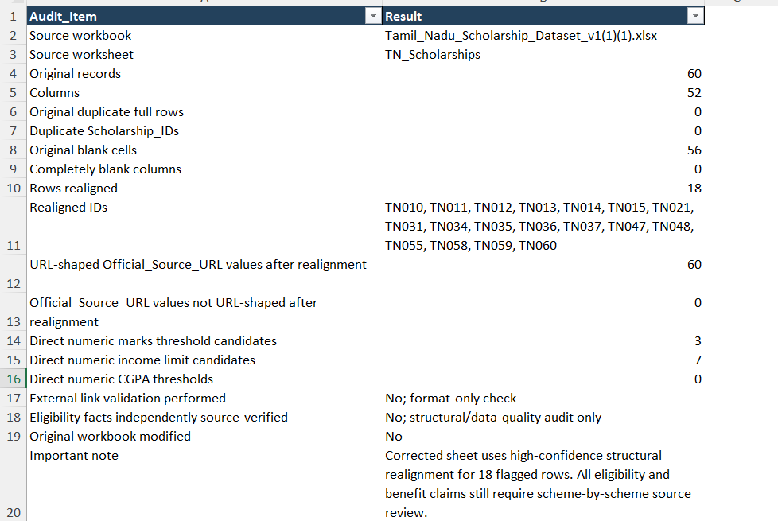
AUDIT SUMMARY:-

Slide 16
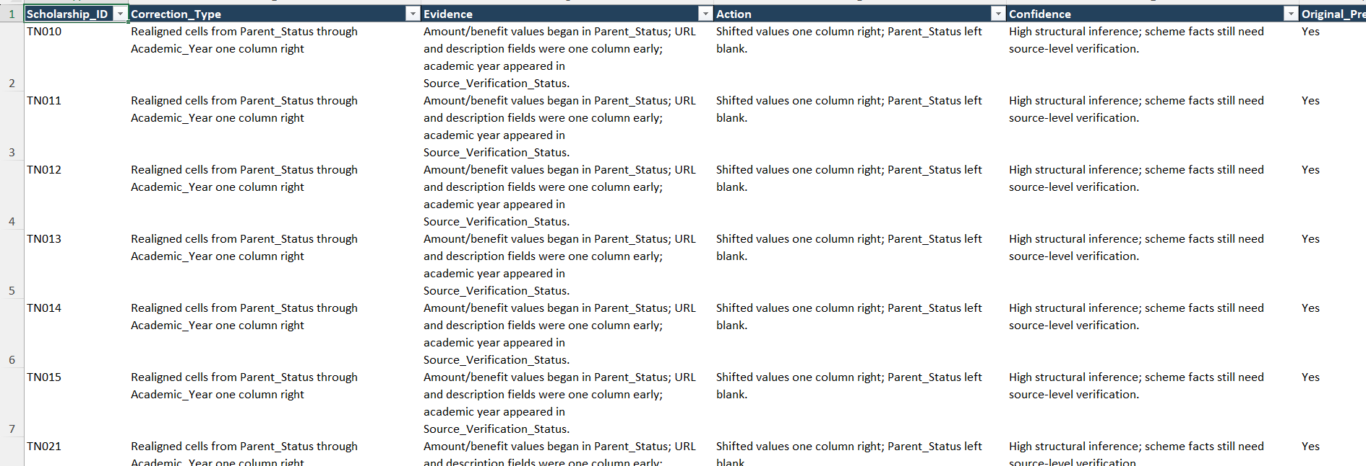
CORRECTION LOG:-

Slide 17
FILES LINK:-
Link for EDA file:-https://docs.google.com/spreadsheets/d/1Zza3Uyt4g2LUzxYkqp2_bYqtKxvuaSzg/edit?usp=drive_link&ouid=111484125300589088907&rtpof=true&sd=true
Link for clean audit file:-
https://docs.google.com/spreadsheets/d/1443Ow4EAjrM57a1wdqEX3ZR9-X9F22aq/edit?usp=drive_link&ouid=111484125300589088907&rtpof=true&sd=true

Slide 18
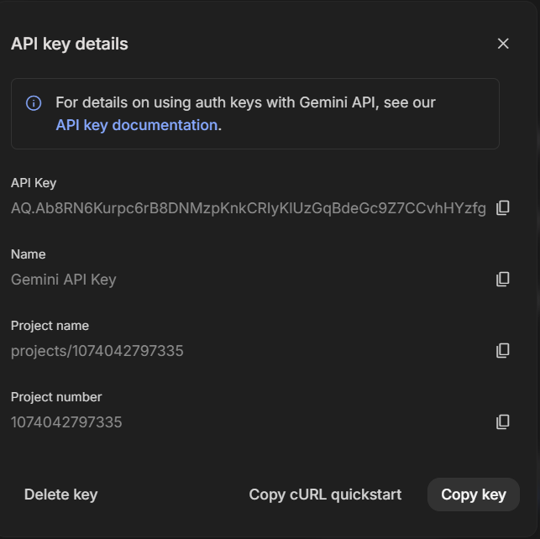
GEMINI LLM INTEGRATION
GEMINI API KEY:-

Slide 19
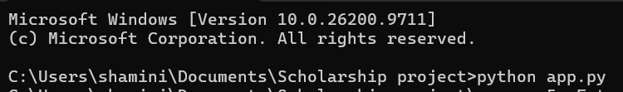
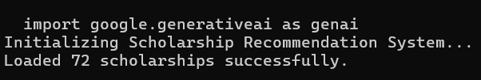
TERMINAL EXECUTION:-
Execution Query:-
Loading the Dataset:-

Slide 20
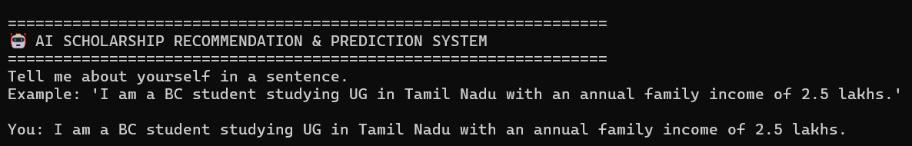
TERMINAL EXECUTION:-
Terminal Interface and User input:-
Processing the recommendation:-

Slide 21
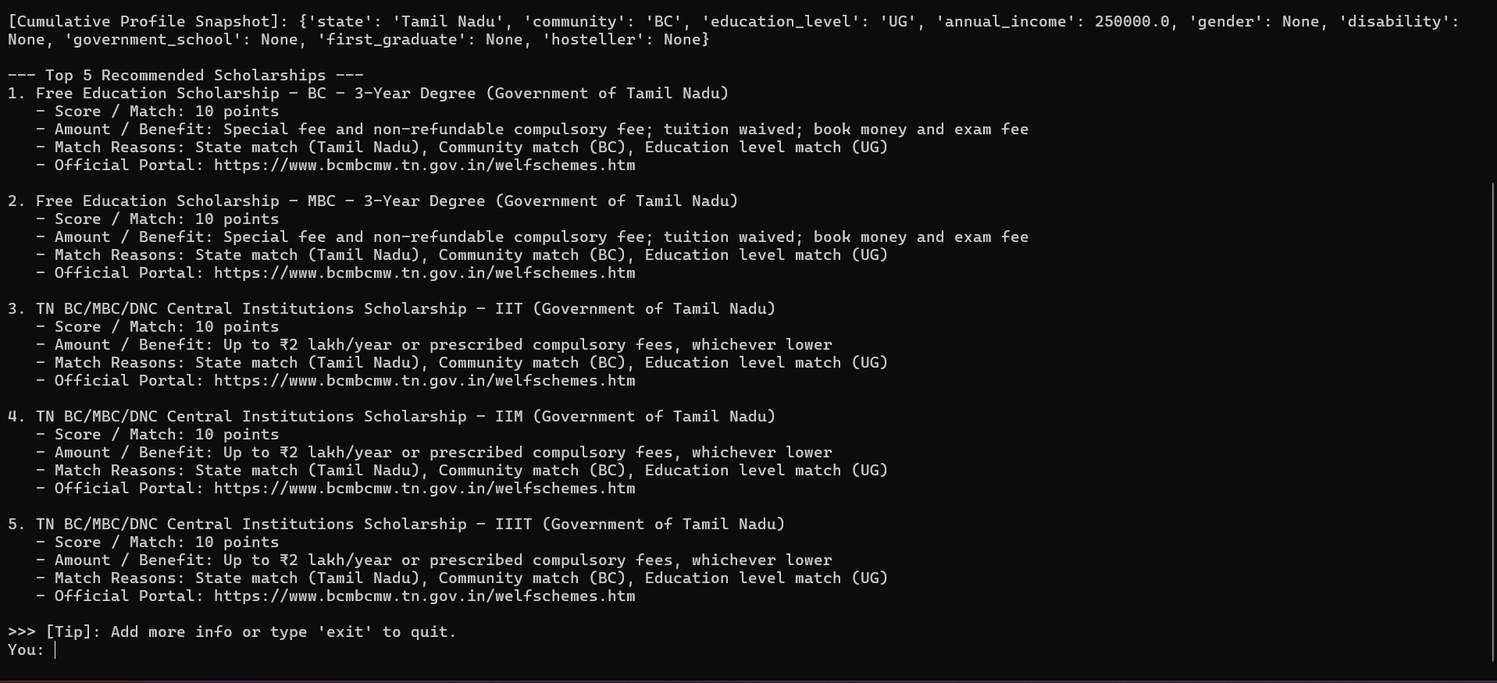
TERMINAL EXECUTION:-
Scholarship Recommended:-

Slide 22

TERMINAL EXECUTION:-
Adding more informations:-
If the user adds the information like “GENDER”, the system will add the new information with the old one and re-recommend the top 5 scholarships
For example, consider the user enters the gender as female
The system adds this to the existing information and recommend the top 5 scholarships

Slide 23
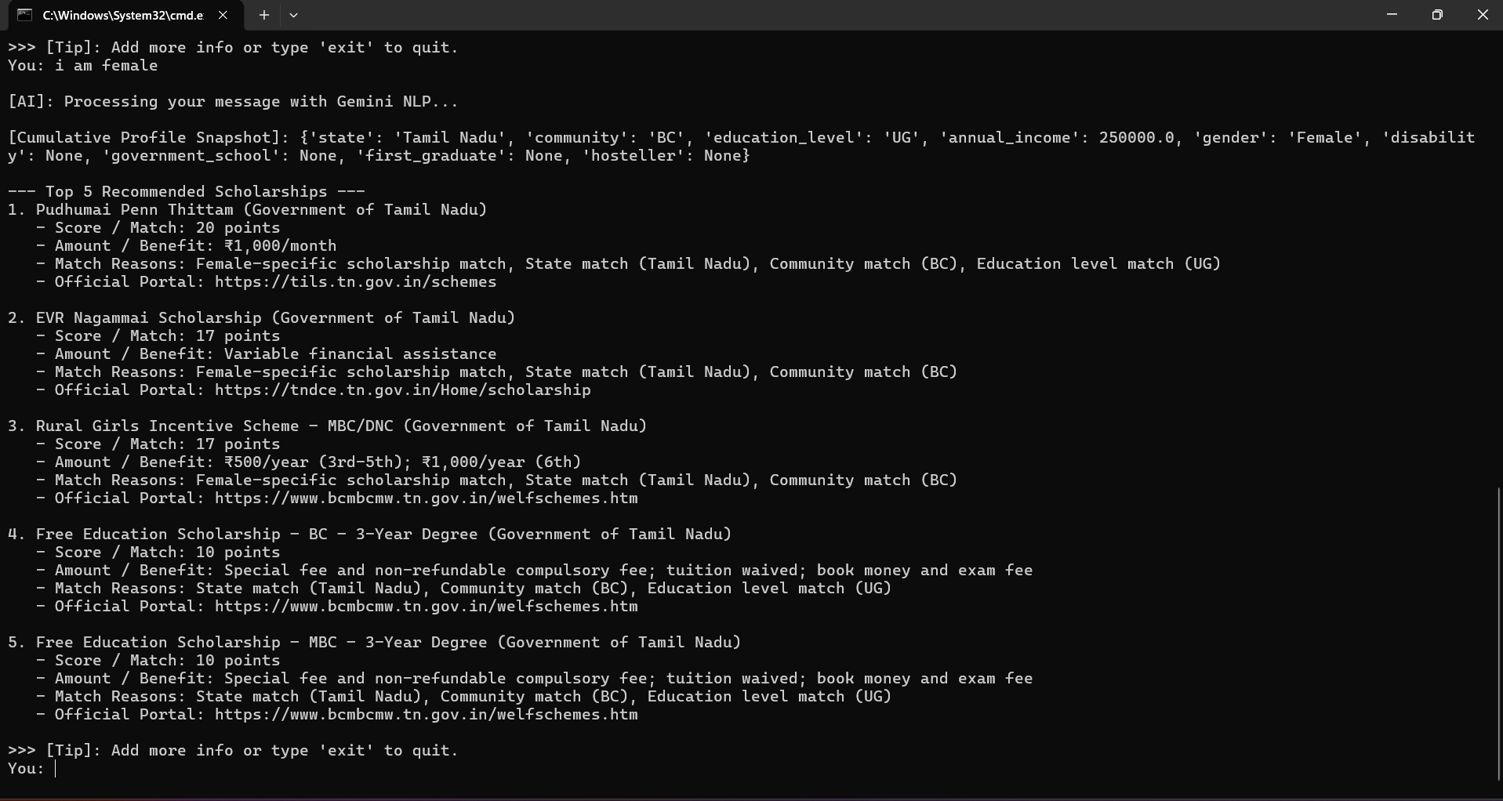
TERMINAL EXECUTION:-
New recommendations:-

Slide 24

TERMINAL EXECUTION:-
Adding another set of information:-
To the already existing informations, the user can add informations at each stage.It will again merge all the informations collecte and again it will recommend the scholarships based on the information collected
For example, at first stage the user enters basic details, at second stage the user added a information ‘GENDER’. Consider the user wants to add another information about ‘DISABILITY STATUS’.
The system will add new informations and once again recommend the scholarship based on the informations it is having.

Slide 25
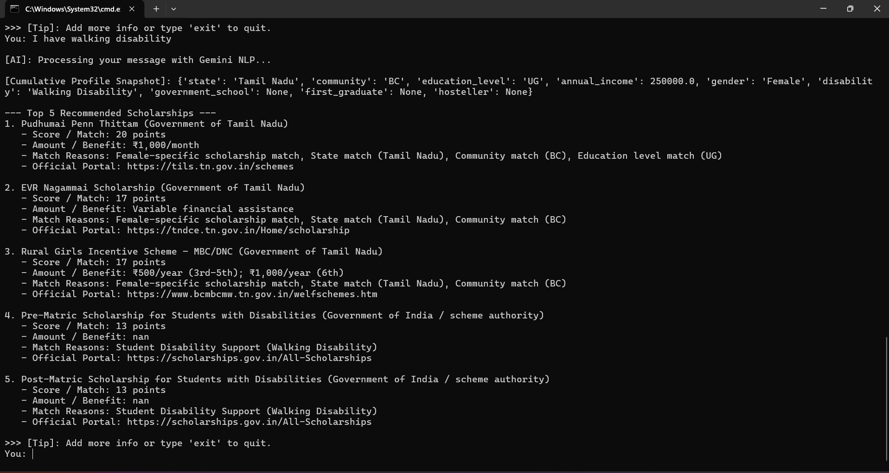
TERMINAL EXECUTION:-
New recommendations:-

Slide 26
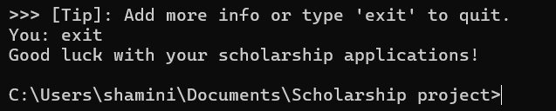
TERMINAL EXECUTION:-
Termination:-

Slide 27
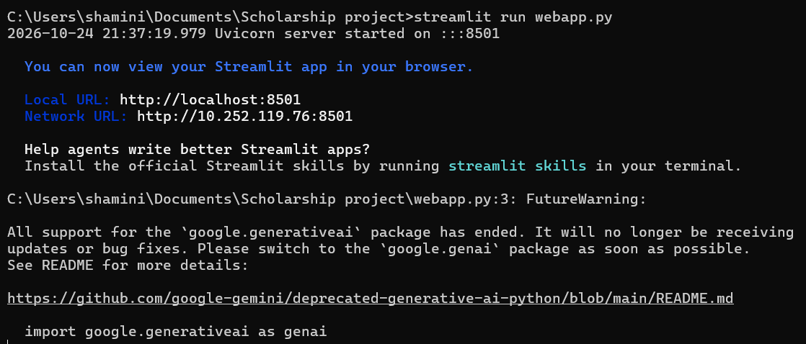
WEBSITE CREATED
In our project, we are not completed the website. We have started to build the website using streamlit. It has to be updated . We will finish our work with the website creation in the upcoming days.
Running the website using STREAMLIT:-

Slide 28
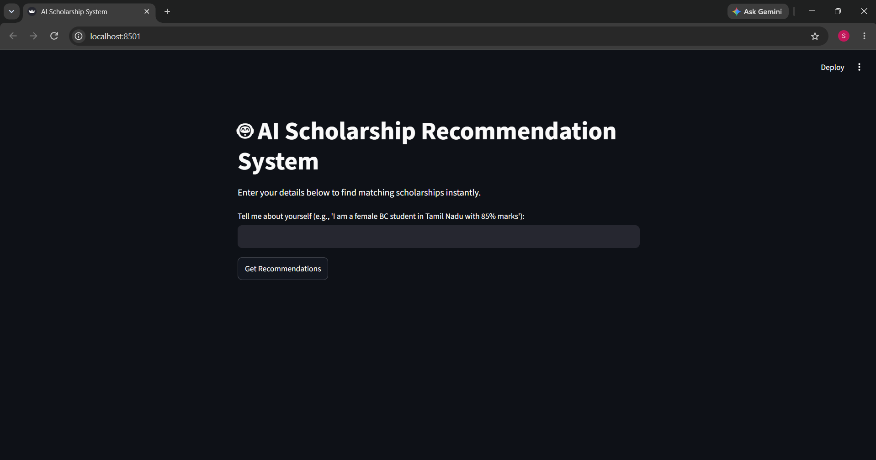
WEBSITE CREATED
Home page:-

Slide 29
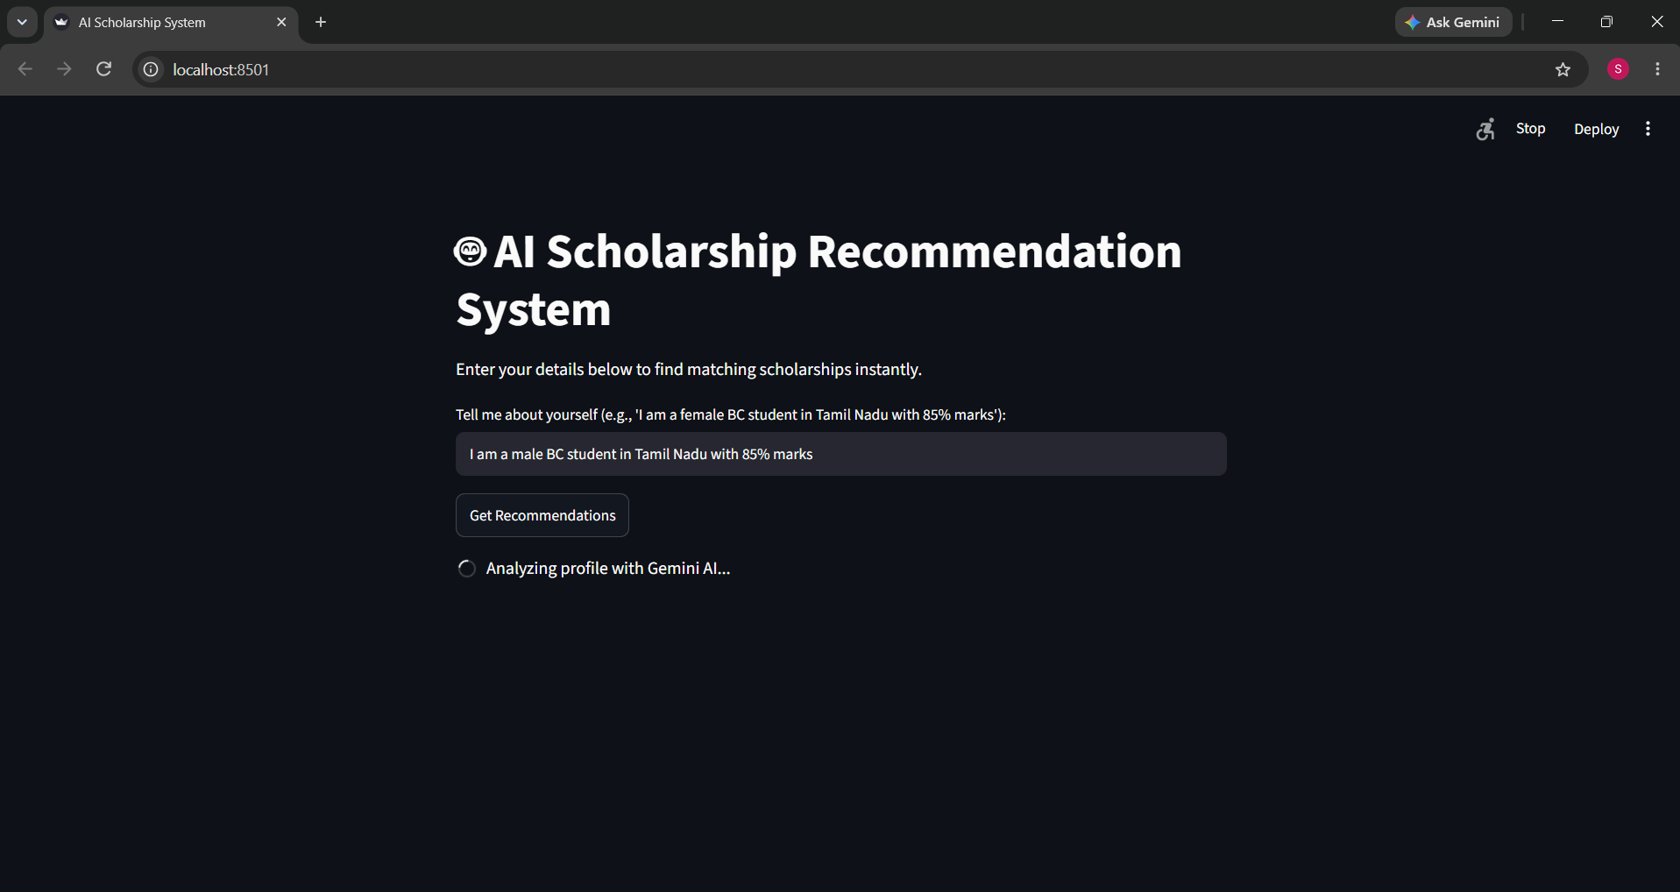
WEBSITE CREATED
User input:-

Slide 30
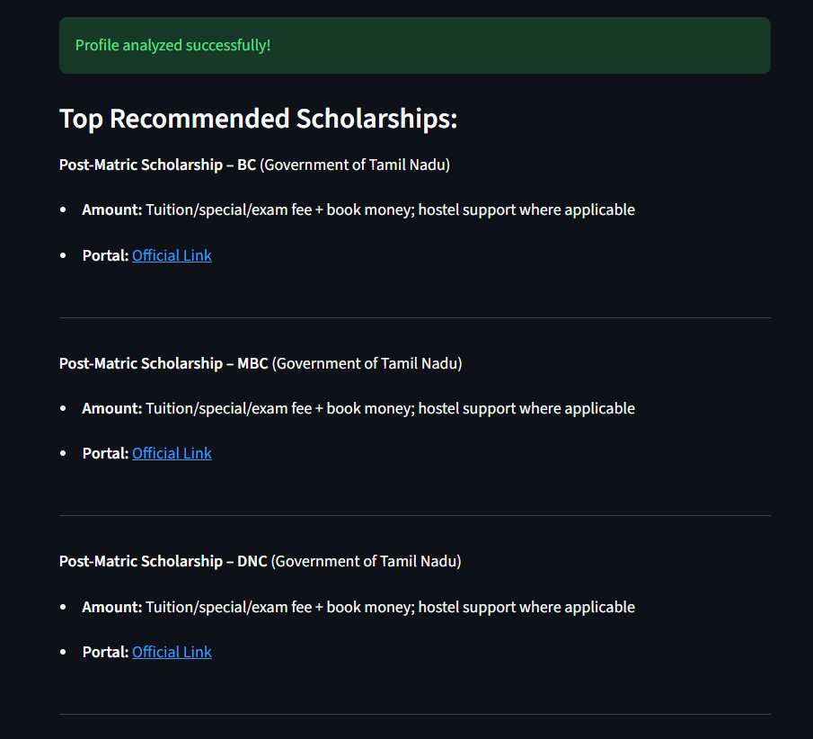
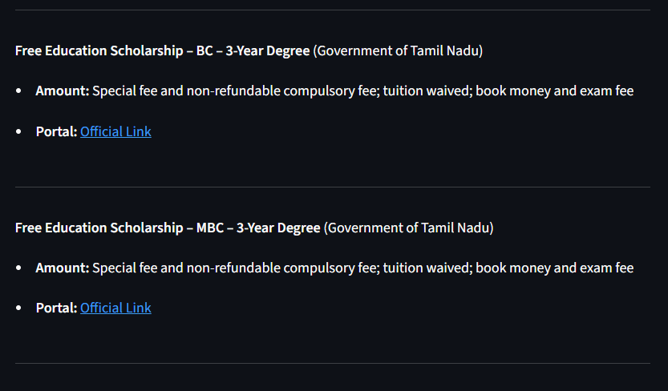
WEBSITE CREATED
Recommendations:-

Slide 31
References
[1] K. Verbert, N. Manouselis, X. Ochoa, P. Wolpers, H. Drachsler, B. Bosnic, and E. Duval, “Context-Aware Recommender Systems for Learning: A Survey and Future Challenges,” IEEE Transactions on Learning Technologies, vol. 5, no. 4, pp. 318–335, 2012. doi: 10.1109/TLT.2012.11.
[2] F. Leite da Silva, “A Systematic Literature Review on Educational Recommender Systems for Teaching and Learning: Research Trends, Limitations and Opportunities,” Education and Information Technologies, vol. 28, no. 3, pp. 3289–3328, 2023. doi: 10.1007/s10639-022-11341-9.
[3] Y. Zhang and X. Chen, “Explainable Recommendation: A Survey and New Perspectives,” Foundations and Trends in Information Retrieval, vol. 14, no. 1, pp. 1–101, 2020. doi: 10.1561/1500000066.
[4] “On Explaining Recommendations with Large Language Models: A Review,” 2025. Verify the complete author, journal and publication details from the original article before submission.
[5] Google, “Gemini API Documentation.” https://ai.google.dev/gemini-api/docs
[6] Streamlit, “Streamlit Documentation.” https://docs.streamlit.io/
[7] Python Software Foundation, “Python Documentation.” https://docs.python.org/3/
1
2
3
4
6

